Slide 1
Layouts in Android

Slide 2
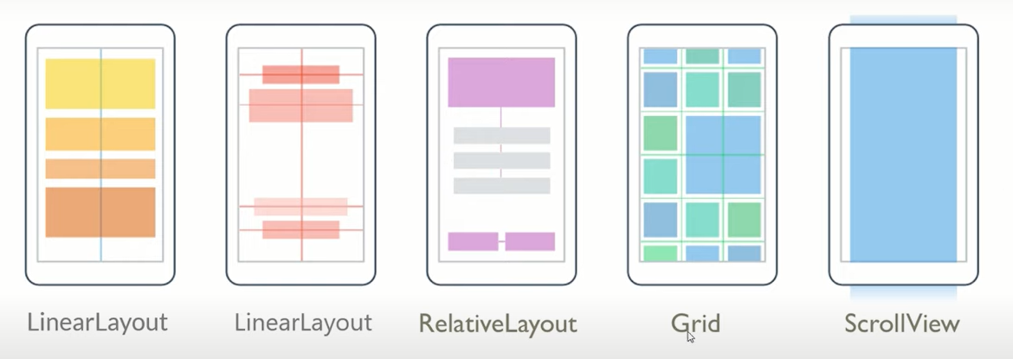
Layouts

Slide 3
a margin is the space around an element's border, while padding is the space between an element's border and the element's content.

Slide 4
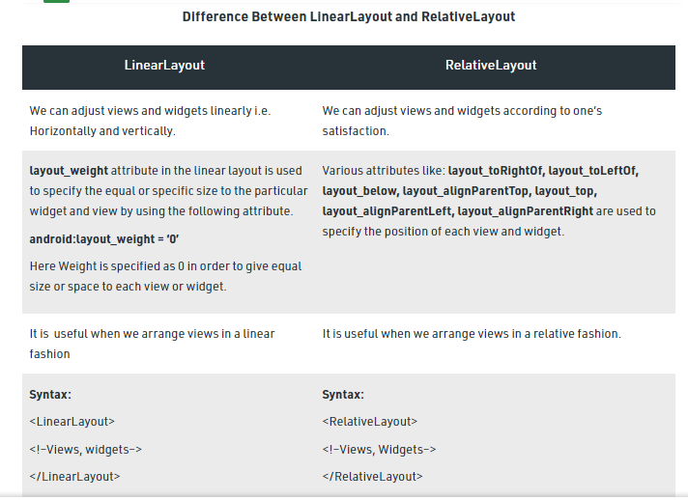

Slide 5
